Slide 1
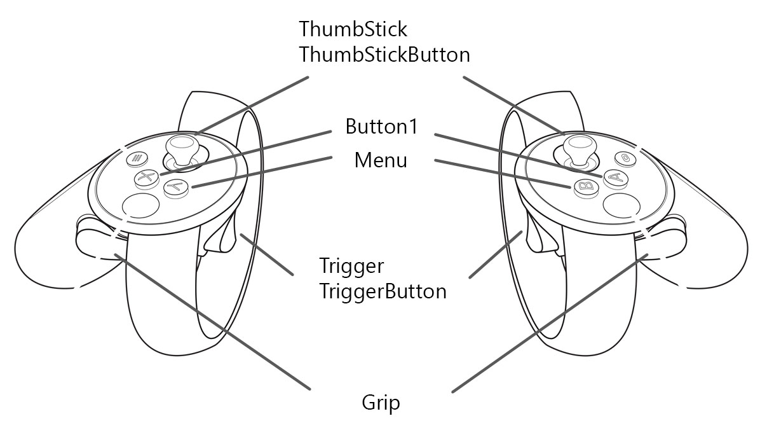
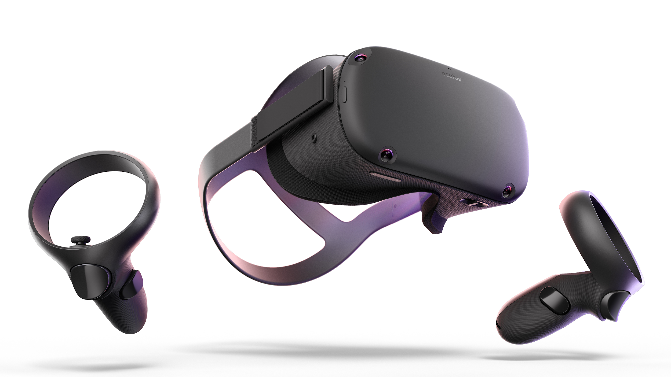
Virtual reality headset
Airidas Janonis
Eligijus Kiudys
Martynas Girdžiūna
IFF - 7 / 14
It is an interactive simulated experience SYSTEM that can be similar to or completely different from the real world. Parts Graphics display lenses, tracking sensor cameras, battery, headset control buttons (power, volume level), tracking controllers.
Rules 1. Safety boundary set-up 2. Display safety boundary level 3. Emit sound 4. Track controllers/hands 5. Display virtual content 6. Get user input 7. In case of low battery, inform user

